Slide 1
Profile of a Virginia Graduate
May 24, 2018

Slide 3
“The Board of Education has heard from students, families and educators that earning a diploma should be about more than passing a prescribed series of courses and tests. The board also has heard from higher education, businesses, and the military that graduates need skills and attributes such as critical thinking, creative thinking, communication, collaboration, and citizenship, to be successful in life. In response, the board is redesigning the high school experience and developing a ‘Profile of a Virginia Graduate.’”
Virginia Department of Education

Slide 4
Innovation Center and Project Based Learning

Slide 5
Diploma Types
Standard
22 standard units of credit
5/22 verified credits (pass the course + the accompanying assessment)
Advanced Studies
26 standard units of credit
5/26 verified credits (pass the course + the accompanying assessment)
Applied Studies
Available to students with disabilities who complete the requirements of their Individualized Education Program (IEP) and who do not meet the requirements for other diplomas

Slide 6
Discipline Area | Standard Diploma |  | Advanced Diploma
 | Standard Credits | Verified Credits | Standard Credits | Verified Credits
English *Performance Based Assessment | 4 | 2* | 4 | 2*
Mathematics | 3 | 1 | 4 | 1
Laboratory Science | 3 | 1 | 4 | 1
History & Social Sciences *Performance Based Assessment | 3 | 1* | 4 | 1*
Health and Physical Education | 2 |  | 2
Foreign Languages |  |  | 3
Fine Arts or Career & Technical Education |  |  | 1
Fine Arts or Career, Technical Education, or Foreign Language | 2
Economics and Personal Finance *can be used to satisfy History and Social Sciences credit | 1 |  | 1
Electives | 4 |  | 3
Total | 22 | 5 | 26 | 5

Slide 7
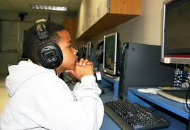
Verified Credits
English Reading, Mathematics, & Science
Pass one end-of-course standards of learning (SOL) test in any course for which end-of-course SOL tests are available
History and Social Science & English Writing
Meeting locally developed criteria which meets BOE guidelines that defines criteria for work such as independent study, work sample portfolio, demonstrated performance, community service or internships, or approved locally developed performance assessments

Slide 8
2

Slide 10
Support for Profile of a Graduate...
All students should graduate from high school with the knowledge and skills to help them succeed in postsecondary education and the workplace.
To be able to prosper in an interdependent world, each student should acquire a body of essential knowledge and skills, including literacy and math skills. To this end, schools should encourage students to assume a well-rounded, rigorous, and challenging course of study that consists of core academic courses as well as a variety of elective courses.
National Association of Secondary School Principals

Slide 11
Recognizing the Profile of a Graduate...

Slide 12
WPS Currently Recognizes….
Valedictorian is an academic title of success for the student with the highest ranking Grade Point Average.
Salutatorian is an academic title of success for the second-highest ranking Grade Point Average.
Graduate with High Honors Students with GPA of 3.75 and above
Graduate with Honors Students with GPA of 3.50 to 3.74

Slide 13
Point to Ponder...
“Efforts to improve the academic achievement of all students and to prepare each and every student for postsecondary education and training have rendered past methods of sorting and comparing students obsolete.”
“Research indicates that up to 50% of schools no longer report class rank.”
“Schools should hold high expectations for all students and should promote academic excellence for each and every student, not just a select few.”
“Schools should encourage and recognize academic excellence in a spirit of cooperation, not intense competition that sets one student against another.”
(National Association of Secondary School Principals)

Slide 14
More Points to Ponder...
“A system of class rank should not carry with it an underlying assumption that academic success is a scarce commodity available only to a select few students.”
“The system of calculating class rank should allow students to improve through persistence and hard work and should ensure that the success of one student should not be at the expense of another student.”
(National Association of Secondary School Principals)

Slide 15
How do Divisions in Region IV Recognize Achievement of Graduates?

Slide 16
System | Class Rank | Val/Sal
Page | Yes | Yes
Loudoun | Yes | Yes
Warren | Yes | No
Shenandoah | Yes | Yes
Madison | Yes | Yes
Fauquier | Yes | No
Orange | Yes | Yes
Culpeper | No | No
Fairfax | No | No
Clarke | Yes | Yes
Frederick | Yes | Yes

Slide 17
Region IV Survey

Slide 18
Region IV Survey

Slide 19
Additional Comments from Region IV Survey...
Utilize the recognition of "Honor Graduate" for all students meeting a published standard (Warren)
Decile Rank, not the traditional ranking system. No valedictorian or salutatorian. (Fauquier)
Top percentile bands. We allow students to apply to be a speaker at graduation. A few are selected. (Culpeper)

Slide 20
Class of 2022…
How should Profile of a Graduate students be recognized?
Notes:
profile

Slide 21
Possibilities...
Individual Achievement (Valedictorian/Salutatorian)?
Criteria Based (Honor Graduates)?
Achievement Bands(Cum Laude..., decile, etc.)?

Slide 22
Tonight’s Listening Session
Purpose - To gather input on how we should recognize the Profile of a Graduate students
Format - WPS panel will listen to input from the audience.
Speakers - Prior to providing input, please state your full name.

Slide 23
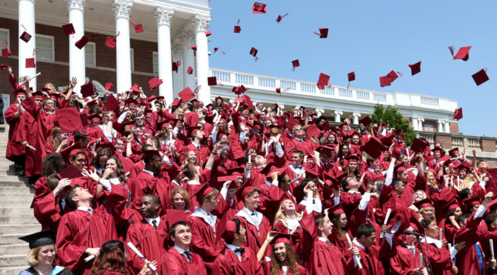
Learning for All...Whatever it Takes...

